Slide 1
Gemini

Slide 2
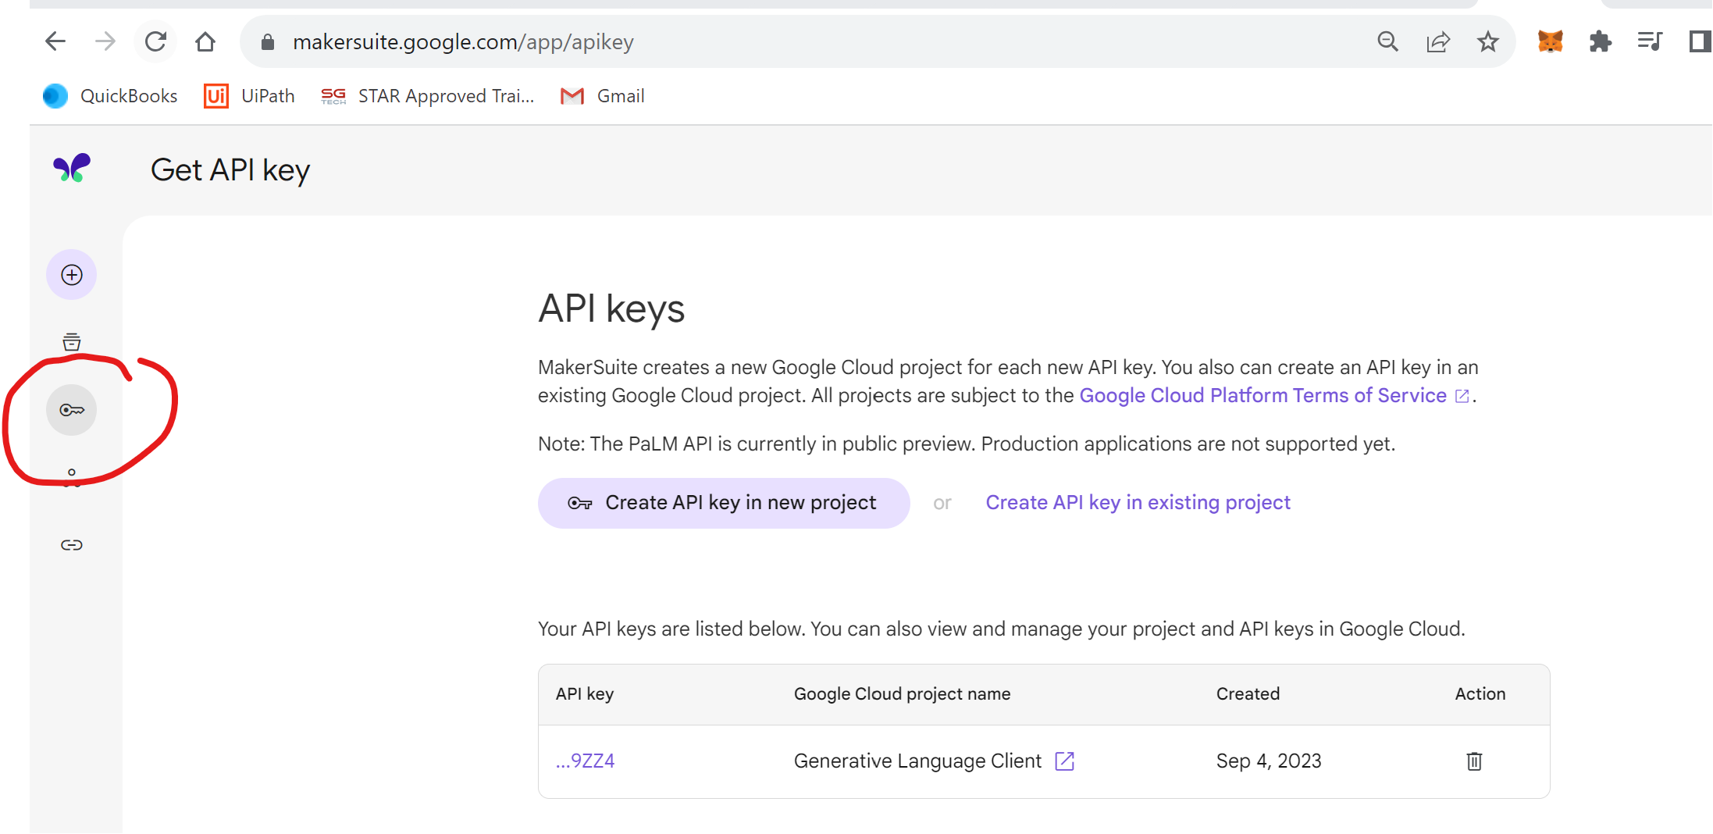
API
Create API: https://makersuite.google.com/

Slide 3
Google - makersuite
Discontinue dates: https://cloud.google.com/vertex-ai/generative-ai/docs/learn/model-versions
https://ai.google.dev/gemini-api/docs/quickstart?lang=python
Code: https://colab.research.google.com/drive/19DLb3YxURSZ2ifbJ2eT3pcP_7vLVKRYE?usp=drive_link

Slide 4
Colab – follow the video - https://1drv.ms/v/c/f2f2b67b8c6b3629/EeRqXojBbUhMucXM6Ztcco8BeVdJfLNsPDngJ2klCjxY_g?e=iCUKpJ
Go to drive
Add application – Colab
Add Secret Key

Slide 5
Google – Gemini
pip install google-generativeai
import google.generativeai as genai
import os
from google.colab import userdata
api = userdata.get('makersuite')
genai.configure(api_key=api)
model = genai.GenerativeModel("gemini-1.5-flash")
r = model.generate_content("describe singapore.")
print(r.candidates[0].content.parts[0].text)

Slide 6
Front Back End
from flask import Flask,render_template,request
import google.generativeai as palm
palm.configure(api_key="")
defaults = { 'model': "models/text-bison-001"}
app = Flask(__name__)
@app.route("/",methods=["GET","POST"])
def index():
if request.method == "POST":
t = request.form.get("txt")
r = palm.generate_test(**defaults,messages=t)
return(render_template("index.html",result=r.last))
else:
return(render_template("index.html",result="waiting"))
if __name__ == "__main__":
app.run()
Hide api
import os
api_key = os.getenv("MAKERSUITE_API_TOKEN")
palm.configure(api_key=api_key)
<html>
<h1>My First chat in Cloud</h1>
<form action="/" method="post">
<p>Please enter the your question : </p>
<p><input type="text" name="txt"></p>
<p><input type="submit" value="Enter"></p>
</form>
<p>The reply is {{result}}</p>
</html>

Slide 7
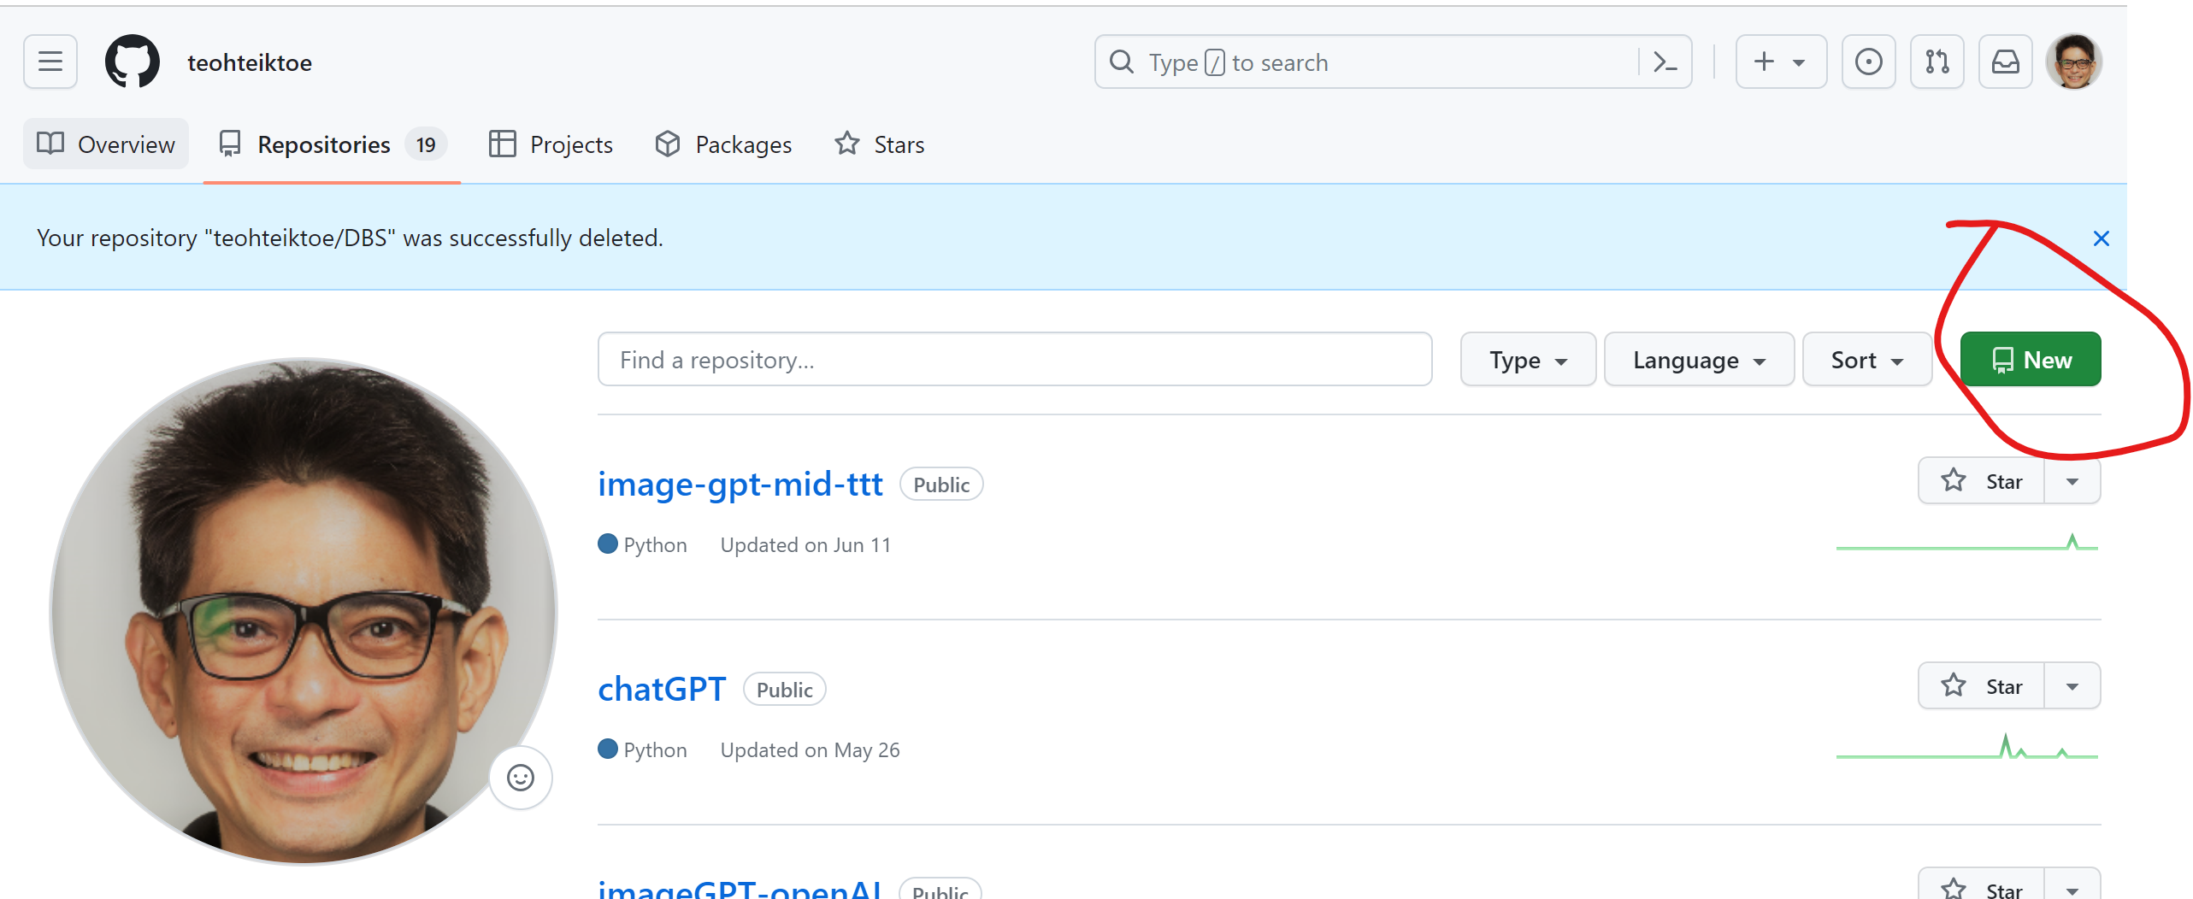
Deploy in render - need to create new repository in github
requirements.txt
flask
replicate
Gunicorn
google-generativeai
openai

Slide 8
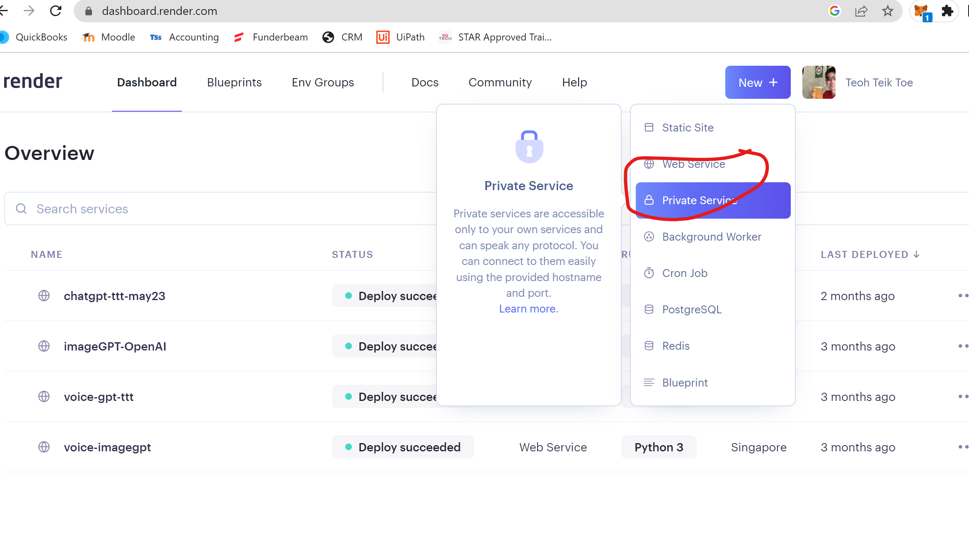
Render.com – need to create web service and link to github remember to select runtime as python3 start command - gunicorn app:app

Slide 9
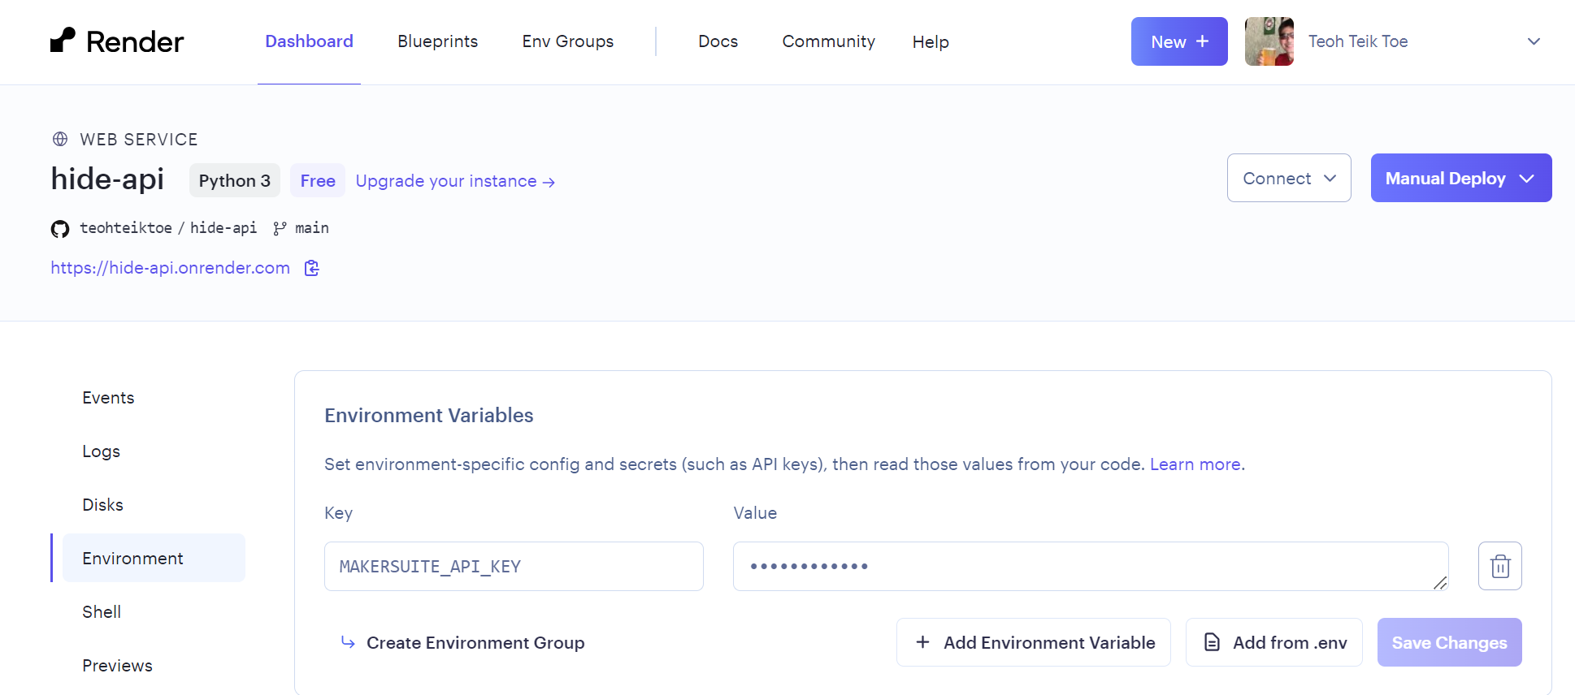
To hide API
import os
makersuite_api_key = os.getenv('MAKERSUITE_API_KEY')

